Slide 1
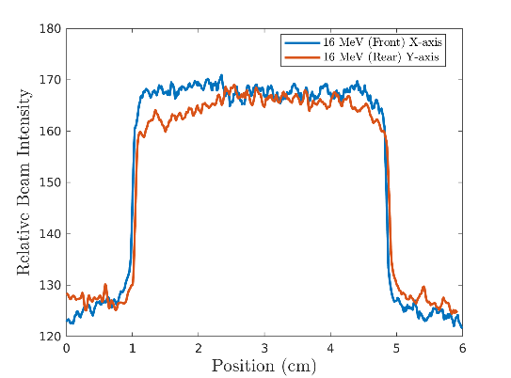
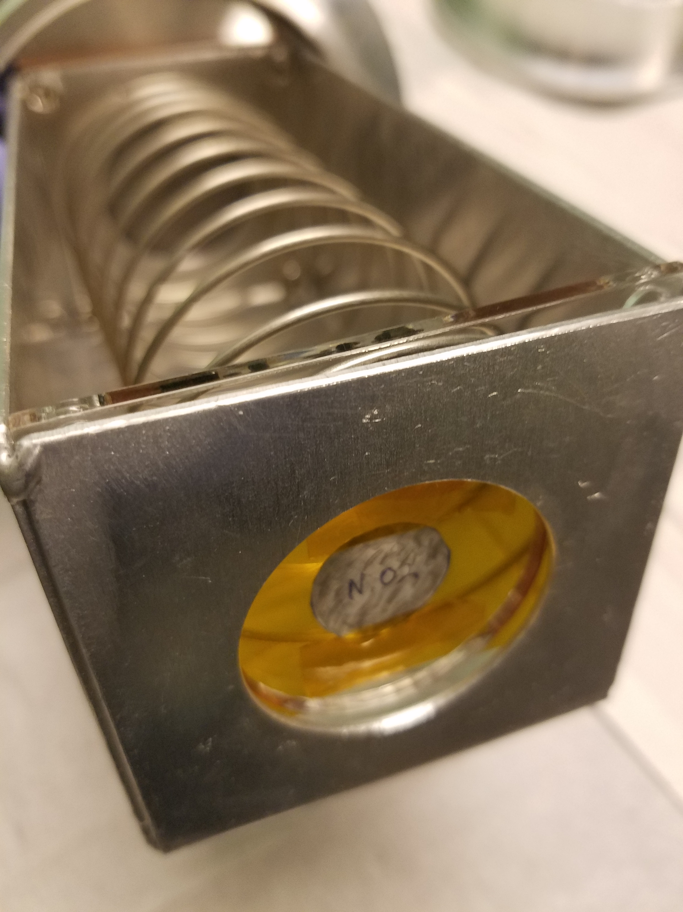

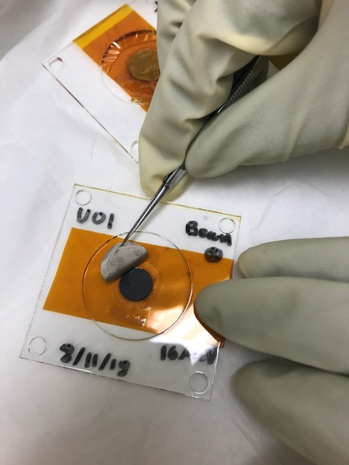
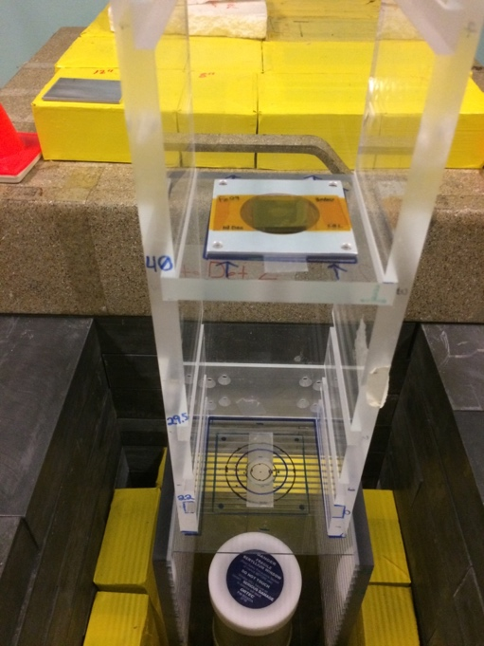
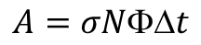
Two≈200 mg 93% ²³⁵U samples were irradiated at the LBNL 88-Inch cyclotron in 12 and 16 MeV deuteron beams
Beam profile measured
Using GAFChromic film
Stacked Target Holder
Deuterons @
12, 16 MeV
$$A=σNt$$
The ²³⁵U sample was “overfilled” with beam shifting “areal” distribution from target to beam
HPGe counter

Slide 2
Post-irradiation counting shows the 642.3 keV g-ray from the decay of the ²³⁶Np isomeric state (t_{½}=22.5 h)
Neptunium-236g (t_{1/2}=1.5 · 10⁵ a) is used for IDMS determination of ²³⁷Np (t_{1/2}=2.14 · 10⁶ a).
²³⁸U(p,3n)^{236m+g}Np experimental measurements show a 99.9 : 0.1 favoring of ²³⁷Np : ^{236g}Np
The formation of short-lived isomer ^{263m}Np (22.5h) generated via ²³⁵U(d,n) was quantified for two energies non-destructively after 60 minutes (16 MeV) and 9 hours (12 MeV) of deuteron irradiation at LBNL in August 2018.
Preliminary analysis shows EoB ²³⁵U(d,n)^{236m}Np production yields of 29.95 kBq/uAh at 16 MeV and 5.15 kBq/uAh at 12 MeV.
^{236g}Np and ²³⁷Np production cannot be quantified through decay spectroscopy: irradiated ²³⁵U foils have been shipped to LANL for ICP-MS analysis.
²³⁸U(p,3n)^{236m+g}Np planned for Spring 2019, to measure the narrow 22 MeV <E_{p}< 27 MeV window for clean ^{236m+g}Np production
Analysis underway by UCB postdoc Andrew Voyles
Gamma-ray spectra from ²³⁵U foils irradiated at 12 MeV (top) and 16 MeV (bottom)

Slide 3
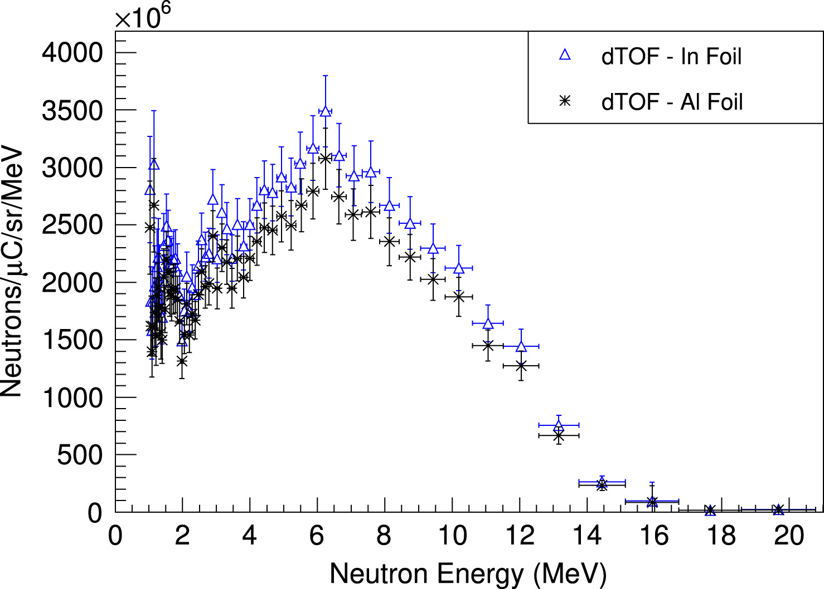
The LBNL/UCB nuclear data group is characterizing the use of “secondary” neutron beams for isotope production
≤ 50 MeV deuterons
Thick Be breakup target
Energetic secondary neutrons
(n,p) and/or (n,2n) target
[1] K. P. Harrig, et al., “Neutron Spectroscopy for pulsed beams with frame overlap using a double time-of-flight technique,” NIM A, 877, pp. 359–366, 2018.
Produces a focused (~5°), intense (ϕ_{n}/ϕ_{d}≈ 3%) energetic secondary neutron flux (ESNF) from breakup of primary deuteron beam.
ESNF can be used to produce high specific-activity radionuclides via (n,2n), or charge exchange reactions such as (n,p) and (n,α).
Neutron volumetric range allows for trivial scale-up of production through increased target mass
Development supported under Research Development and Training in Isotope Production Proposal

Slide 4
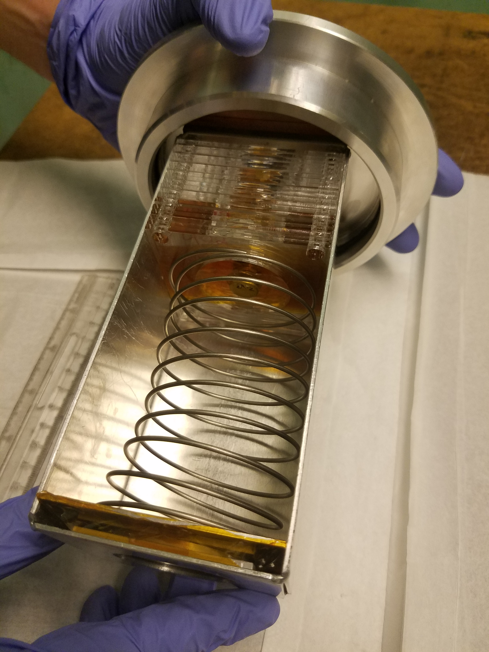
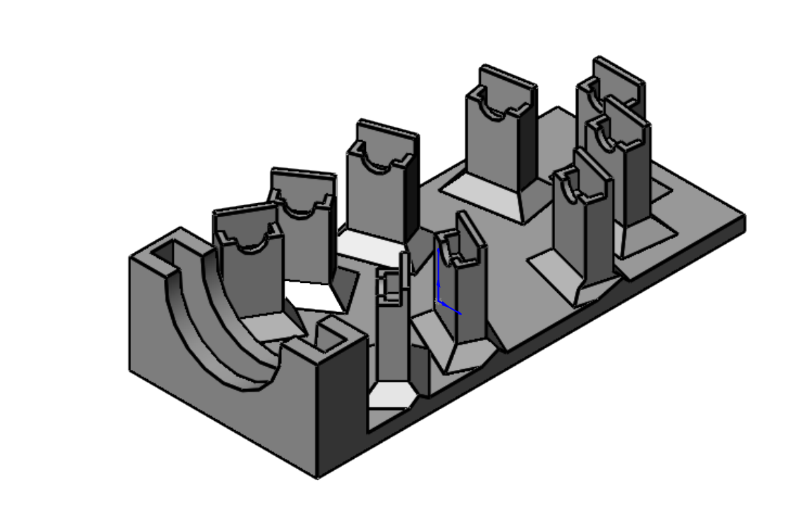
The LBNL/UCB nuclear data group is characterizing the use of “secondary” neutron beams for isotope production
Target + monitor foils
First development run took place in August 2018: simultaneous production of ^{64,67}Cu via energetic Zn(n,x), using 33 and 16 MeV deuteron breakup.
^{64,67}Cu are emerging as a “theranostic pair” for simultaneous dose delivery and imaging.
Preliminary analysis shows EoB production rates of ⁶⁴Cu:⁶⁷Cu in an approximately 75:1 ratio at 33 MeV and an 800:1 ratio at 16 MeV.
Selection of deuteron energy allows co-production of ^{64,67}Cu in a tunable ratio for applications!
Complete analysis is underway and will form the master thesis for Ms. Nora Pettersen from the University of Oslo.
Irradiation of targets mounted at 0° to maximize neutron fluence
Deuteron breakup neutrons have an energy-angle correlation – the spectrum “hardness” varies with angle off-axis
This provides a second “tuning knob” for the ⁶⁴Cu:⁶⁷Cu ratio!
Experiments in November 2018 and Feb 2019 will better characterize the angular breakup neutron spectrum
Zn
n
6 mm Be breakup target
10°
0°
20°
5°
67Cu
40°
60°
15°
64Cu
Be breakup target
position
30°
50°
Notes:
Mention issues with Levkovski!
Low peak is 54Fe(p,x), high peak is 56Fe(p,x)

Slide 5
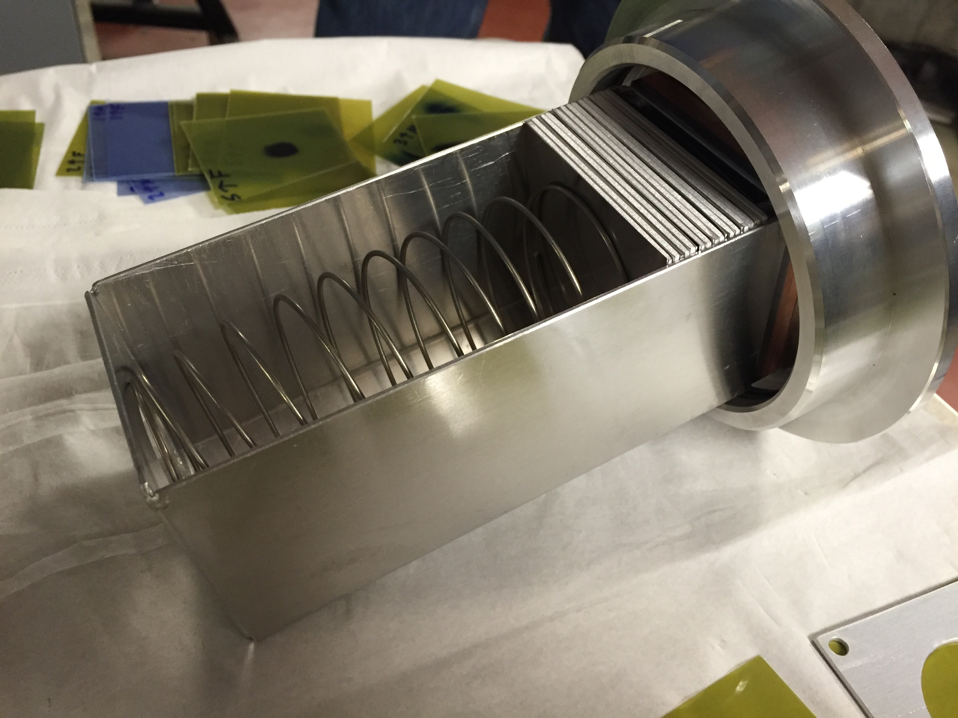
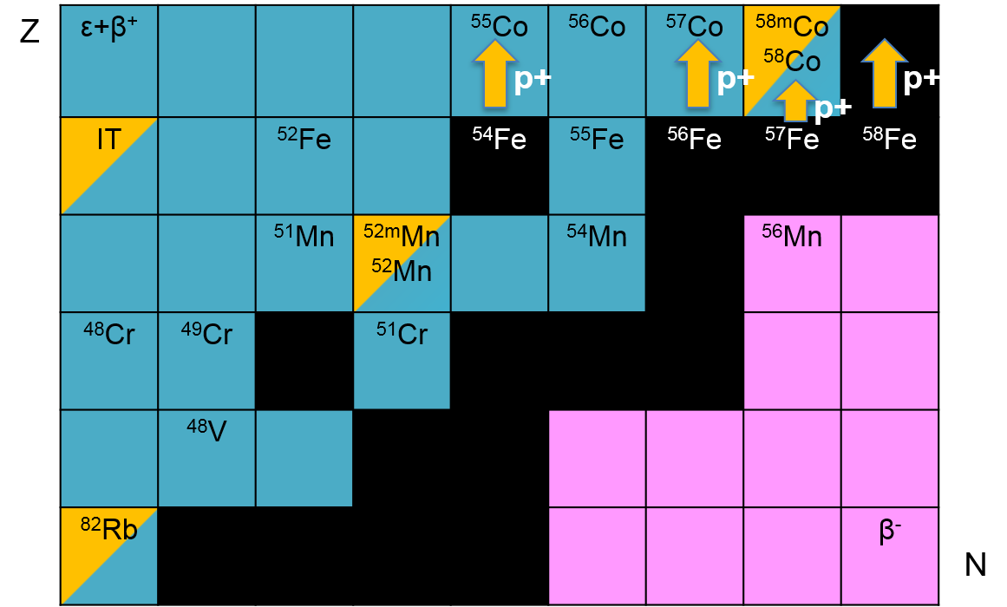
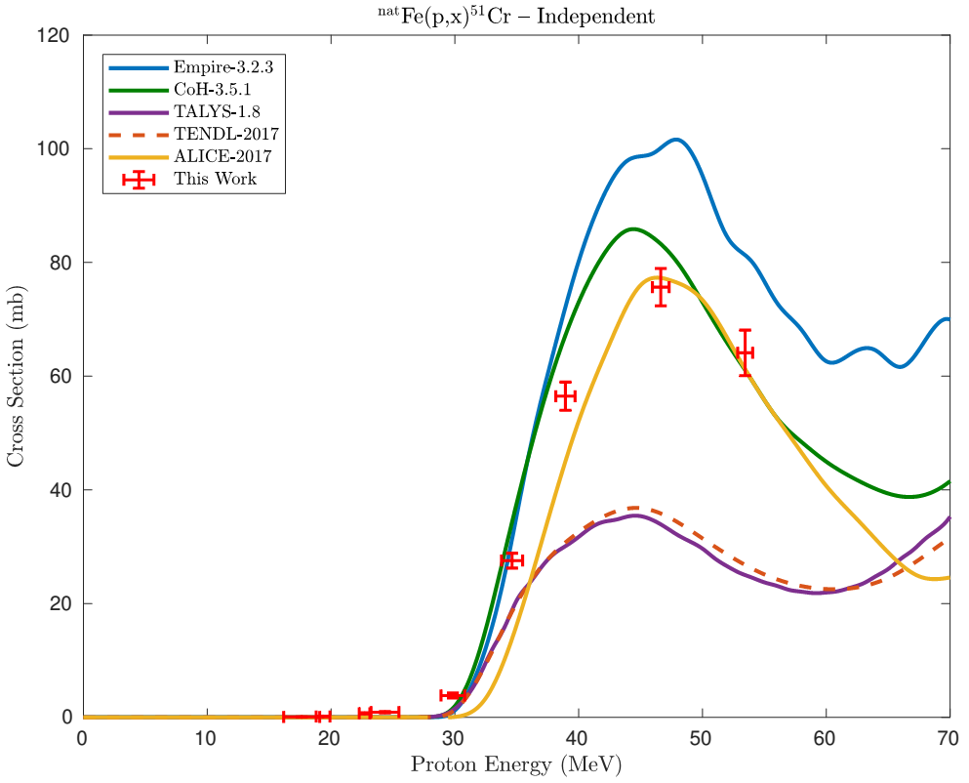
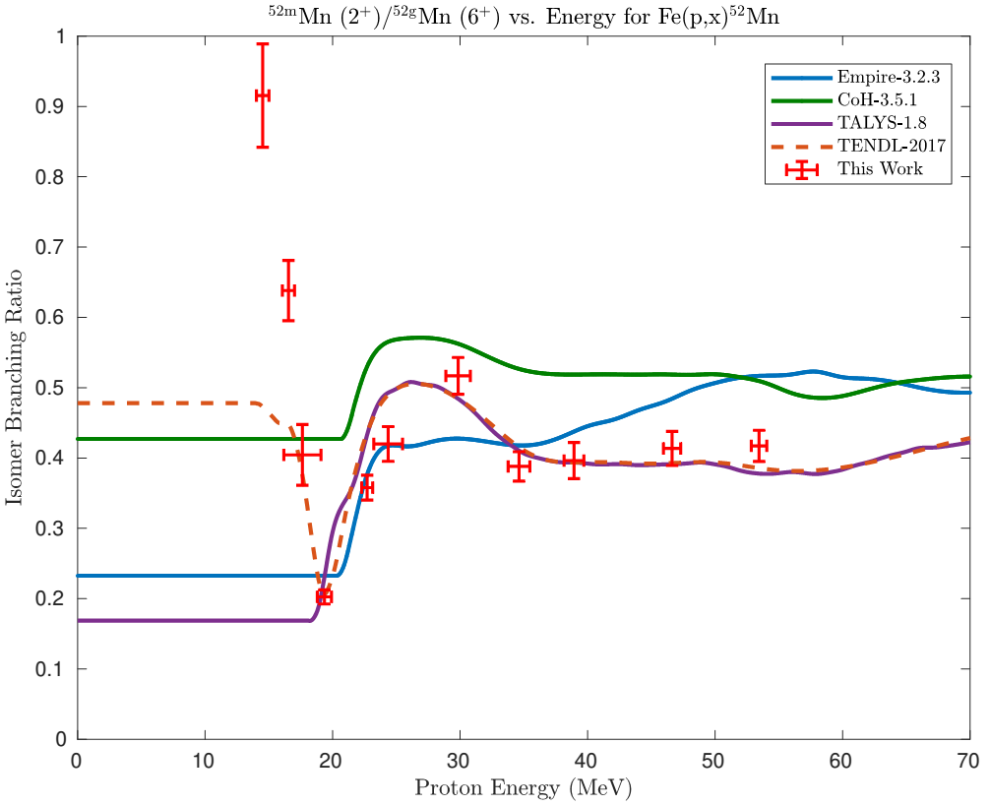
We are also addressing the need for non-standard PET tracers: ^{nat}Fe(p,x)^{51,52}Mn – Novel PET imaging
Two overlapping stacks: E_{p}= 55→15 MeV, 25→0 MeV (120 nA@10 min, 100 nA@20 min)
Emerging medical radionuclides
⁵¹Mn (t_{1/2} = 46 min, 97% β⁺) – short-lived PET tracer for metabolic studies
^{52g}Mn (t_{1/2} = 5.6 d, 29% β⁺) – long-lived PET tracer for neuron tracking, immune studies
Multiple independent reaction channels
Precision excitation functions
Behavior of excited nuclear states
Measurements across wide ranges of energy and product mass provide ideal inputs for improving predictive capabilities of reaction modeling
Notes:
Mention issues with Levkovski!
Low peak is 54Fe(p,x), high peak is 56Fe(p,x)

Slide 6
…as well as “Training and Retaining” the next generation…
Project | Status | Degree
Fe(p,x)^{51,52m,52g}Mn | Manuscript Preparation | PhD, MSc
Zn(n,x)^{64,67}Cu | Analysis Underway | MSc
Ir(d,x)^{193m}Pt | Scheduled: Feb 2019 | MSc
La(p,x)¹³⁴Ce | Manuscript Preparation | PhD
²³⁵U(d,x)^{236m}Np, Tm(d,x)¹⁶⁹Yb | Analysis Underway | n/a
As(p,x)⁷²Se,⁶⁸Ge | Analysis Underway | PhD
⁸⁶Sr(p,x)⁸⁶Y, ⁸⁶Sr(d,x)⁸⁶Y | Scheduled: Feb 2019 | MSc
QMN Development | Analysis Underway | PhD
In addition to measurements, we train our students in dissemination of nuclear data to the user and evaluation communities → compiling each publication into EXFOR, including uncertainty analysis!
Since 2016, this student-led program has generated 1 PhD and 1 MSc, with an additional 3 PhD’s and 2 MSc’s in progress!

